Slide 1
Food Fortification with Folic Acid is Safe:
Global Evidence
Helena Pachón, PhD, MPH
WHO Regional Meeting
Nepal
11 July 2019
Notes:
Good morning ladies and gentlemen.
I would like to thank WHO and in particular Rajesh Mehta for inviting the Food Fortification Initiative to participate in this regional meeting.
I am pleased to share with you global evidence on the safety of fortifying food with folic acid.
At the conclusion of this meeting you will each be given a USB memory stick. It will include this presentation and all of the documents referenced in it.

Slide 2
No adverse consequences
Field 2018
Notes:
Last year, researchers published a review of the evidence on the safety of fortification with folic acid. Here is what they concluded:
“there are no established risks for adverse consequences resulting from existing mandatory folic acid fortification programs that have been implemented in many countries.”
In this presentation, I will show you evidence that has led these and other researchers to conclude that fortification with folic acid is safe.
--
Source:
Martha S. Field, Patrick J. Stover. Safety of folic acid. Annals of the New York Academy of Sciences. 1414:59–71, 2018.

Slide 3
Main messages
Fortifying food with folic acid does not mask vitamin B12 deficiency
Fortifying food with folic acid does not cause cancer or increase deaths from cancer
Free folic acid in blood does not increase cancer or adenoma risk
Fortifying food with folic acid is safe
Notes:
Through this presentation, I hope to convince you that
Fortifying food with folic acid does not mask vitamin B12 deficiency.
Fortifying food with folic acid does not cause cancer or increase deaths from cancer.
Free folic acid in blood does not increase the risk of developing cancer or adenomas.
And, fortifying food with folic acid is safe.

Slide 4


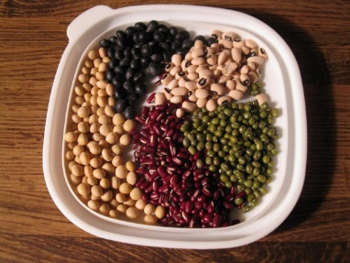

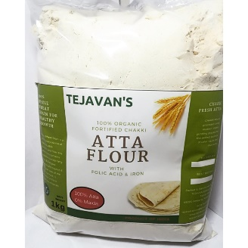

Folic acid in fortified food
Vitamin B9 (Folate)
Food Folate
Supplements
Folic Acid
Fortified Food
Suitor 2000
Notes:
Vitamin B9 is also known as folate.
There are two types of vitamin B9 that we can consume.
[CLICK TO ADVANCE] One is food folate which is naturally found in food such as these vegetables, legumes and meat products.
The second type is folic acid which is a synthetic form of the nutrient.
[CLICK TO ADVANCE] Folic acid can be added to supplements and fortified food.
In this presentation, we are going to focus on folic acid, and mainly on folic acid in fortified food.
--
Source:
Suitor CW & Bailey LB (2000) Dietary folate equivalents: interpretation and application. Journal of the American Dietetic Association 100: 88–94.
Source for images:
Asparagus: https://recipemashups.files.wordpress.com/2008/12/asparagus.jpg
Legumes: http://yang-sheng.com/wp-content/uploads/2012/07/beans.jpg
Green leafy vegetables: https://ljayhealth.files.wordpress.com/2012/02/spinach.jpg
Meat: http://popsgrassfedbeef.org/images/bigstock_Beef_Liver_With_Dill_On_White__3599062.jpg
Supplements: www.jebkinnison.com
Fortified wheat flour: https://my-live-02.slatic.net/p/18/tejavan39s-fortified-chakki-atta-flour-in-1kg-packing-6907-552779651-ff29e643b0b4a6f2504a2d027cd4eefd.jpg

Slide 5
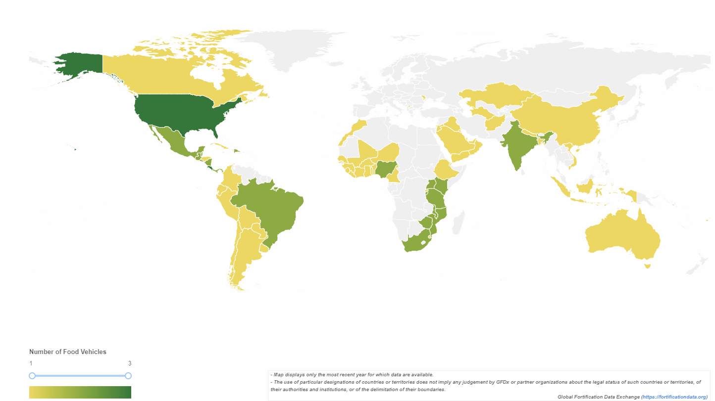
Countries with folic acid in their standard for food fortification
73 Countries Include Folic Acid in their Fortification Standard for 1, 2 or 3 Foods
FortificationData.org
Notes:
Currently, 73 countries include folic acid in their fortification standards for up to 3 foods, including wheat flour, rice and maize flour.
--
Source:
Global Fortification Data Exchange. Map: Number of Food Vehicles with Standards. Accessed 3 July 2019. [http://www.fortificationdata.org.]

Slide 6
Fortifying food with folic acid does not mask vitamin B12 deficiency
Notes:
Let’s start by reviewing evidence that fortifying food with folic acid does not mask vitamin B12 deficiency.

Slide 7


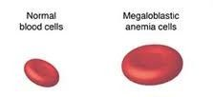
Folate and vitamin B12 deficiencies cause megaloblastic anemia
Folate deficiency
Vitamin B12 deficiency
Causes
Causes
Megaloblastic Anemia
IOM 2008
Megaloblastic anemia is the same as macrocytic anemia
Notes:
Folate deficiency independently causes megaloblastic anemia, that is anemia where the red blood cells are much larger than normal. Anemia is an important public health problem in many countries.
[CLICK TO ADVANCE] Vitamin B12 deficiency also independently causes megaloblastic anemia.
--
Source:
Institute of Medicine. Dietary Reference Intakes for Thiamin, Riboflavin, Niacin, Vitamin B6, Folate, Vitamin B12, Pantothenic Acid, Biotin, and Choline. 2000.
Megaloblastic anemia image: https://i.pinimg.com/236x/47/41/e6/4741e6ce99437a3260364ed6001b9ddf--macrocytic-anemia-b-deficiency.jpg
Blue arrow: https://www.seekpng.com/png/detail/12-122935_blue-arrow-transparent-background.png

Slide 8
Folic acid masking of vitamin B12 deficiency
Megaloblastic anemia due to vitamin B12 deficiency only
If folic acid is provided
If vitamin B12 is not provided
Potentially irreversible neurological conditions persist
Anemia is corrected
“folic acid masking of vitamin B12 deficiency”
Berry 2019
Notes:
Let’s say a person has megaloblastic anemia due to vitamin B12 deficiency only. This is often observed in older adults because they no longer absorb vitamin B12 from the diet as well as they did when they were younger.
In these individuals, if folic acid is provided, the anemia is corrected.
[CLICK TO ADVANCE] However, if vitamin B12 is not provided to them, then their vitamin B12 deficiency can persist and with it, potentially irreversible neurological conditions such as memory loss, disorientation and frank dementia.
[CLICK TO ADVANCE] The fact that folic acid can correct megaloblastic anemia while not treating the underlying vitamin B12 deficiency is known as “folic acid masking of vitamin B12 deficiency.”
--
Source:
RJ Berry. Lack of historical evidence to support folic acid exacerbation of the neuropathy caused by vitamin B12 deficiency. American Journal of Clinical Nutrition 2019.

Slide 9
History of folic acid masking of vitamin B12 deficiency
1940s
Routine clinical tests did not measure folate or vitamin B12 status
Folic acid identified and synthesized before vitamin B12
Nutritional cause of megaloblastic anemia could not be determined
Folic acid readily provided to treat megaloblastic anemia, regardless of its nutritional cause
People with megaloblastic anemia due to vitamin B12 deficiency were treated with folic acid (and not vitamin B12) and developed neurological problems associated with vitamin B12 deficiency
Berry 2019
Notes:
The history of folic acid masking of vitamin B12 deficiency goes back to the 1940s.
At that time, routine clinical tests did not measure folate or vitamin B12 status. Therefore, the nutritional cause of megaloblastic anemia could not be determined.
[CLICK TO ADVANCE] And, folic acid was identified and synthesized before vitamin B12, meaning that folic acid was readily provided to treat megaloblastic anemia, regardless of its nutritional cause.
[CLICK TO ADVANCE] So, putting these two situations together, people with megaloblastic anemia due to vitamin B12 deficiency were treated with folic acid instead of vitamin B12. Consequently, these people developed neurological problems associated with vitamin B12 deficiency.
--
Source:
RJ Berry. Lack of historical evidence to support folic acid exacerbation of the neuropathy caused by vitamin B12 deficiency. American Journal of Clinical Nutrition 2019.

Slide 10

In contemporary clinical practice, no masking of vitamin B12 deficiency
Today
Routine clinical tests can measure folate and vitamin B12 status
People at risk for vitamin B12 deficiency (e.g. older adults) are screened
The appropriate nutrient is administered depending on the cause of the anemia
Office of the Primer Minister’s Chief Science Advisor & the Royal Society Te Aparangi 2018, Berry 2019
Notes:
Today, however, the story is very different. Routine clinical tests can measure folate and vitamin B12 status. People at risk for vitamin B12 deficiency such as older adults are screened. And the appropriate nutrient is administered depending on the cause of the anemia.
--
Source:
Office of the Primer Minister’s Chief Science Advisor & the Royal Society Te Aparangi. The Health Benefits and Risks of Folic Acid Fortification of Food. New Zealand, 2018.
RJ Berry. Lack of historical evidence to support folic acid exacerbation of the neuropathy caused by vitamin B12 deficiency. American Journal of Clinical Nutrition 2019.
Photo: https://www.sbs.com.au/yourlanguage/sites/sbs.com.au.yourlanguage/files/styles/body_image/public/1-gettyimages-155374522.jpg?itok=oLZyqWLs&mtime=1535095271

Slide 11
Study to assess if fortification with folic acid causes masking of vitamin B12 deficiency
People with low vitamin B12 status and no anemia who consume food fortified with folic acid
Folic acid is provided
Vitamin B12 is not provided
Anemia does not develop
Vitamin B12 deficiency develops
Mills 2003
Notes:
Is there any evidence that fortification with folic acid causes masking of vitamin B12 deficiency?
In one study conducted in the USA, researchers surmised that people with low vitamin B12 status and no anemia who consumed food fortified with folic acid could be at risk of developing vitamin B12 deficiency.
In other words, in these individuals, since folic acid is provided through fortification in the USA, they will not develop anemia.
However, since vitamin B12 is not provided through fortification in the USA, they may develop vitamin B12 deficiency.
--
Source:
Mills JL et al. Low vitamin B-12 concentrations in patients without anemia: the effect of folic acid fortification of grain. Am J Clin Nutr 2003;77:1474–7.

Slide 12
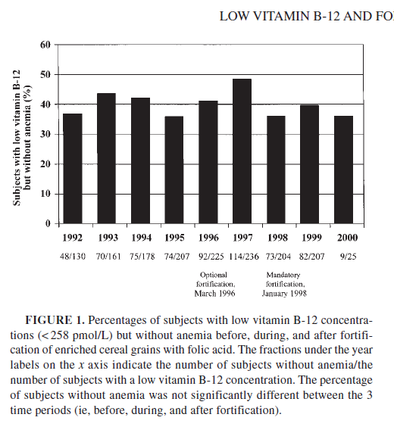
Mandatory grain fortification in USA does not mask vitamin B12 deficiency
Before
Initiation
After
1992-1995: before mandatory grain fortification with folic acid
1996-1997: mandatory grain fortification with folic acid declared; fortification voluntary
1998+: mandatory grain fortification in effect
Bars: percent of people with low vitamin B12 status who did not have anemia
If folic acid masks vitamin B12 deficiency: expect the bar height to increase
Mills 2003
Notes:
This graph has data from 1992 to 2000 from the United States.
[CLICK TO ADVANCE] From 1992 to 1995, there was no mandatory grain fortification with folic acid in the USA; this is labeled as the “before fortification” period.
[CLICK TO ADVANCE] From 1996 to 1997, industry could voluntarily fortify grains but did not need to; this is labeled as the “initiation” period.
[CLICK TO ADVANCE] From 1998 forward is when mandatory grain fortification was in effect; this is labeled as the “after” period.
[CLICK TO ADVANCE] The bars represent the % of people with low vitamin B12 status who did not have anemia.
[CLICK TO ADVANCE] We would expect the prevalence to increase in the “after” period if folic acid from fortification was masking vitamin B12 deficiency.
What we can see from the graph is that the prevalence did not change across the three fortification periods. These data suggest that folic-acid fortification does not mask vitamin B12 deficiency.
--
Source:
Mills JL et al. Low vitamin B-12 concentrations in patients without anemia: the effect of folic acid fortification of grain. Am J Clin Nutr 2003;77:1474–7.

Slide 13
Fortifying with folic acid does not mask vitamin B12 deficiency
Vitamin B12 deficiency, no anemia
Vitamin B12 deficiency, no macrocytosis
Fortification: USA, mandatory fortification with folic acid
Population: adults > 50 years
Sample: nationally representative (NHANES 1991-94 & NHANES 2001-06)
Macrocytosis: enlarged red blood cells
If folic acid masks vitamin B12 deficiency, expect increase in prevalence between the pre and the post fortification periods
Qi 2014
Notes:
Another study from the USA, published 11 years after the previous study, aimed to answer the same question.
On the left we have individuals with vitamin B12 deficiency and no anemia, and on the right those with vitamin B12 deficiency and no macrocytosis. Macrocytosis refers to enlarged red blood cells, like those we would observe in megaloblastic anemia.
The gray bars represent the period before mandatory fortification with folic acid in the USA and the white bars represent the period after mandatory fortification.
If folic acid was masking vitamin B12 deficiency, we would expect an increase in either of these groups during the post-fortification period.
We see that there was no change in the prevalence for these groups, suggesting there was no masking of vitamin B12 deficiency by fortification with folic acid.
--
Source:
Yan Ping Qi, Ann N. Do, Heather C. Hamner, Christine M. Pfeiffer, and Robert J. Berry. The prevalence of low serum vitamin B-12 status in the absence of anemia or macrocytosis did not increase among older U.S. adults after mandatory folic acid fortification. J. Nutr. 144: 170–176, 2014.

Slide 14
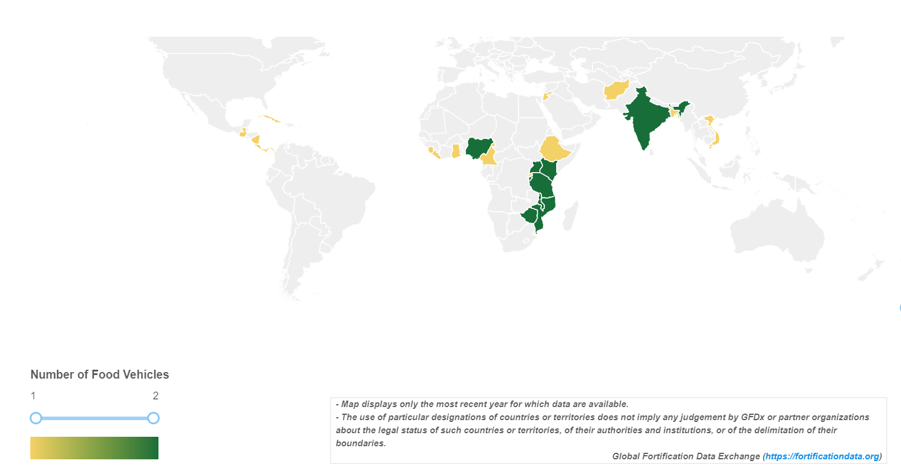
Vitamin B12 is added to fortified wheat flour and rice
25 Countries Include Vitamin B12 in their Fortification Standard for 1 or 2 Foods
FortificationData.org
Notes:
In case you are wondering, yes it is possible to add vitamin B12 to fortified foods including wheat flour and rice.
Currently, 25 countries include vitamin B12 in their fortification standards for 1 or 2 foods.
--
Source:
Global Fortification Data Exchange. Map: Number of Food Vehicles with Standards. Accessed 3 July 2019. [http://www.fortificationdata.org.]

Slide 15
Summary
“Masking of vitamin B12 deficiency” did not occur because folic acid was provided; it occurred because vitamin B12 was not provided to people with vitamin B12 deficiency
With modern diagnostic tools, people at risk of vitamin B12 deficiency can be diagnosed and treated with vitamin B12
Food fortification with folic acid does not mask vitamin B12 deficiency
Vitamin B12 can be added to foods through fortification
Notes:
In summary, historical “masking of vitamin B12 deficiency” did not occur because folic acid was provided; it occurred because vitamin B12 was not provided to people with vitamin B12 deficiency.
With modern diagnostic tools, people at risk of vitamin B12 deficiency can be diagnosed and treated with vitamin B12.
Evidence from the United States indicates that food fortification with folic acid does not mask vitamin B12 deficiency.
And, vitamin B12 can be added to foods through fortification

Slide 16
Fortifying food with folic acid does not cause cancer or increase deaths from cancer
Notes:
Now, let’s review evidence that fortifying food with folic acid does not cause cancer or increase deaths from cancer.

Slide 17
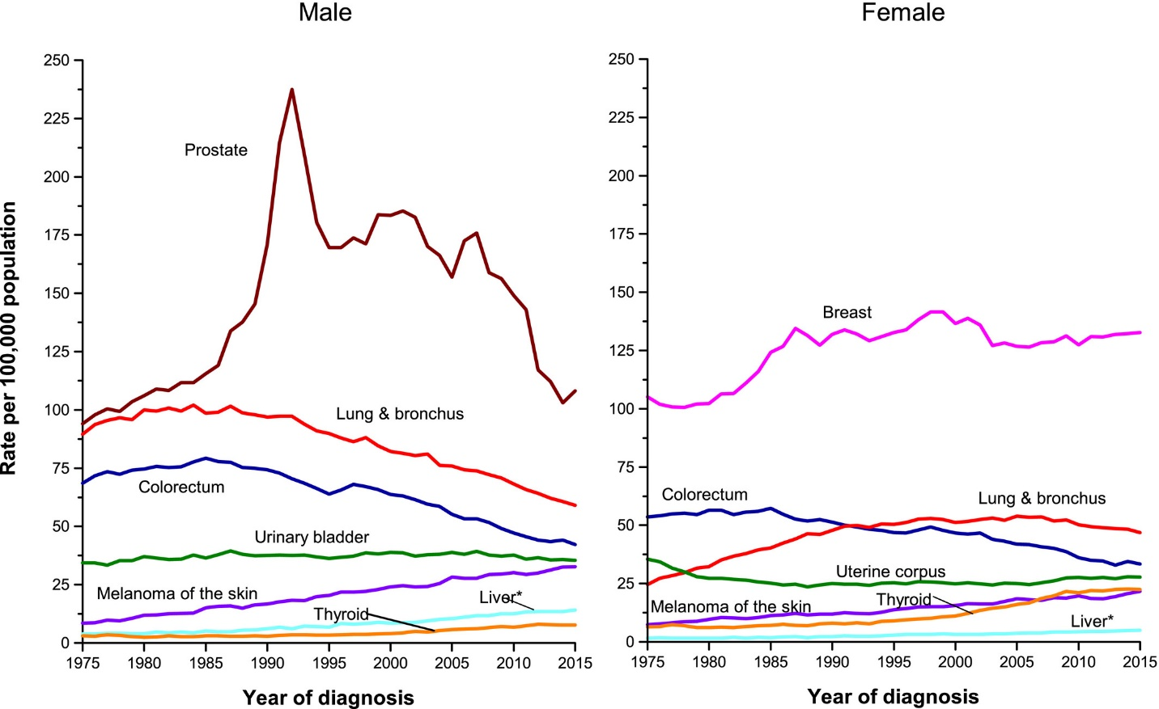
Fortifying with folic acid does not cause cancer
Cancer Rate per 100,000 Population, USA
1973: voluntary fortification of breakfast cereals with folic acid
1973: voluntary fortification of breakfast cereals with folic acid
1998: mandatory grain fortification with folic acid
1998: mandatory grain fortification with folic acid
Male
Female
Siegel 2019
Notes:
Here we have two graphs with the rate of colorectal cancer per 100,000 population in the United States. As you can see in the horizontal axis, the year of cancer diagnosis ranges from 1975 to 2015.
The left-hand side has the data for males and the right-hand side has the data for females.
The dark blue line for men shows a reduction in the number diagnosed with colorectal cancer during this period. The dark blue line for women shows the same downward trend.
[CLICK TO ADVANCE] Voluntary fortification of breakfast cereals with folic acid began in 1973.
[CLICK TO ADVANCE] Mandatory fortification of grains with folic acid became effective in 1998.
These data suggest there is no increase in the number of people diagnosed with colorectal cancer beginning with the voluntary fortification period and extending into the mandatory fortification period.
In other words, there is no evidence that fortification with folic acid increases the number of people being diagnosed with colorectal cancer.
--
Source:
Siegel R et al. Cancer statistics, 2019. CA: A Cancer Journal for Clinicians. 2019.

Slide 18
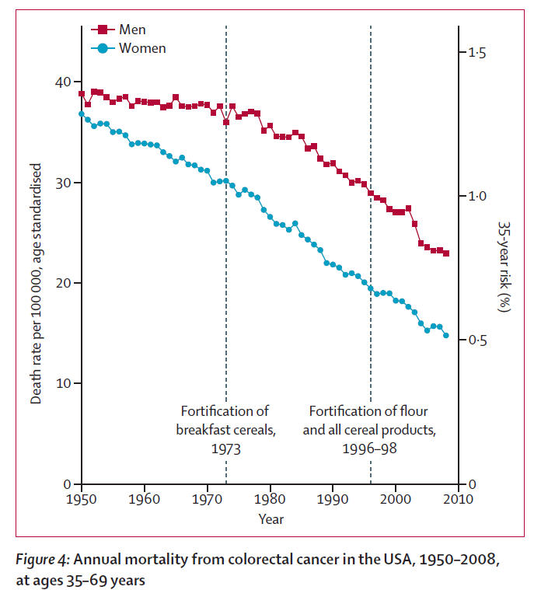
Fortifying with folic acid does not increase deaths from cancer
Vollset 2013
Notes:
A related question is whether more people are dying from colorectal cancer due to fortification with folic acid.
Researchers reviewed data on the annual mortality in the United States from colorectal cancer from 1950 to 2010, which is the timeline that appears along the horizontal axis. They note in the dashed vertical lines that voluntary fortification of breakfast cereals began in 1973 and that mandatory flour fortification with folic acid became effective in 1998.
The data are presented for men in red and women in blue.
For both women and men, there was a decrease in annual deaths from colorectal cancer over this 60-year period.
It’s clear from the graph that the downward trend in annual deaths from colorectal cancer has not changed since the introduction of voluntary and mandatory fortification with folic acid in the USA.
These data suggest that folic-acid fortification does not increase deaths from colorectal cancer.
--
Source:
Vollset SE et al. Effects of folic acid supplementation on overall and site-specific cancer incidence during the randomised trials: meta-analyses of data on 50 000 individuals. Lancet January 25, 2012. http://dx.doi.org/10.1016/S0140-6736(12)62001-7.

Slide 19
Summary
Fortification with folic acid
  Does not increase the number of people diagnosed with colorectal cancer
  Does not increase the number of people with colorectal cancer who die
Notes:
In summary, evidence from the United States shows that fortification with folic acid does not increase the number of people diagnosed with colorectal cancer, or the number of people with colorectal cancer who die.

Slide 20
Free folic acid in the blood does not increase cancer or adenoma risk
Adenomas are benign tumors that can develop into cancer
“Free folic acid” is also referred to as “unmetabolized folic acid”
Notes:
The final point we will review is that free folic acid in the blood does not increase the risk of cancer or adenomas.

Slide 21




After folic acid consumption, free folic acid appears in the blood
Ireland
(Vaish 2016)
Brazil
(Zanin Palchetti 2017)
Canada
(Plumptre 2015)
USA
(Pfeiffer 2015)
“Free folic acid” is also referred to as “unmetabolized folic acid”
Notes:
Evidence from several countries with mandatory or voluntary food fortification with folic acid shows that free folic acid appears in the blood after folic acid consumption.
This has been observed, for example, in Brazil, Canada, Ireland and the USA.
--
Source:
Bailey R et al. Unmetabolized serum folic acid and its relation to folic acid intake from diet and supplements in a nationally representative sample of adults aged >60 y in the United States. Am J Clin Nutr 2010;92:383–9.
Boilson A et al. Unmetabolized folic acid prevalence is widespread in the older Irish population despite the lack of a mandatory fortification program. Am J Clin Nutr 2012; doi: 10.3945/ajcn.111.026633
Pfeiffer CM et al. Unmetabolized Folic Acid Is Detected in Nearly All Serum Samples from US Children, Adolescents, and Adults. J Nutr 2015;145:520–31.
Plumptre L et al. High concentrations of folate and unmetabolized folic acid in a cohort of pregnant Canadian women and umbilical cord blood. Am J Clin Nutr 2015;102:848–57.
Vaish 2016 et al. Synthetic folic acid intakes and status in children living in Ireland exposed to voluntary fortification. Am J Clin Nutr 2016;103:512–8.
Zanin Palchetti C et al. Association between Serum Unmetabolized Folic Acid Concentrations and Folic Acid from Fortified Foods. JOURNAL OF THE AMERICAN COLLEGE OF NUTRITION 2017, VOL. 36, NO. 7, 572–578. [Study conducted in Brazil].
Source for maps: wikipedia

Slide 22
Free folic acid does not increase the risk of total & subtypes of colorectal cancer
Association between Free Folic Acid & Cancer Risk
Cancer | P-value_{trend}
Colorectal cancer | 0.32
Colon cancer | 0.75
Proximal colon cancer | 0.39
Distal colon cancer | 0.11
Rectal cancer | 0.63
P-value compared multi-variable Odds Ratio across three categories of free folic acid: 0 nmol/L, <0.5 nmol/L & > 0.5 nmol/L
Cho 2015
Notes:
However, free folic acid in the blood is not harmful. This study looked at the risk of colorectal cancer and four sub-types of colorectal cancer: colon cancer, proximal colon cancer, distal colon cancer, and rectal cancer.
All of the P-values are greater than 0.05 which suggest that having free folic acid in the blood does not increase the risk of total colorectal cancer, nor the risk of sub-types of colorectal cancer.
--
Source:
Cho E et al. Unmetabolized Folic Acid in Prediagnostic Plasma and the Risk for Colorectal Cancer. JNCI J Natl Cancer Inst (2015) 107(12): djv260.

Slide 23
Free folic acid does not increase the risk of cancer
“There were no associations observed between…the presence of [free folic acid] and risk of cancer incidence.”
“Free folic acid” is also referred to as “unmetabolized folic acid”
Hu 2016
Notes:
This study was published one year later. It used nationally representative data from the USA to examine if there was a relationship between free folic acid in blood and the risk of getting any cancer.
The authors did not present the results in table or figure form. Instead they noted that “there were no associations observed between…the presence of [free folic acid] and risk of cancer incidence.”
Like the previous study, this investigation showed that having free folic acid in the blood does not increase the risk of overall cancer.
--
Source:
Hu J, Juan W, Sahyoun NR (2016) Intake and Biomarkers of Folate and Risk of Cancer Morbidity in Older Adults, NHANES 1999-2002 with Medicare Linkage. PLoS ONE 11(2): e0148697. doi:10.1371/journal.pone.0148697

Slide 24
Free folic acid does not increase the risk of adenomas
Free folic acid (nmol/L) | Interval 1: Relative Risk (95% CI) | Interval 2: Relative Risk (95% CI)
0 | 1.00 (reference) | 1.00 (reference)
> 0 - < 3 | 1.04 (0.81-1.33) | 0.88 (0.62-1.25)
3 - < 20 | 1.00 (0.74-1.35) | 1.31 (0.95-1.82)
> 20 | 0.83 (0.58-1.18) | 0.96 (0.64-1.43)
Interval 1: three years
Interval 2: an additional three years
Adenomas are benign tumors that can develop into cancer
“Free folic acid” is also referred to as “unmetabolized folic acid”
Rees 2017
Notes:
This final study examined if there was a relationship between free folic acid in blood and the risk of getting colorectal adenomas, which are benign tumors that can develop into cancer.
Study participants were followed for two periods: interval one which was three years long and interval two which was an additional three years.
In the first column, they divided up the free folic acid levels in blood into four categories ranging from 0 nanomoles per liter to 20 nanomoles per liter or greater.
They then calculated the relative risk to determine if there was any relationship between free folic acid levels in blood and the risk of developing adenomas.
All of the relative risks with their 95% confidence intervals include 1. This means that free folic acid levels in blood do not increase the risk of adenomas.
--
Source:
Rees JR et al. Unmetabolized Folic Acid, Tetrahydrofolate, and Colorectal Adenoma Risk. Cancer Prev Res; 10(8); 451–8. 2017.

Slide 25
Summary
Consumption of folic acid leads to free folic acid in the blood
Free folic acid in the blood does not increase cancer or adenoma risk
Adenomas are benign tumors that can develop into cancer
“Free folic acid” is also referred to as “unmetabolized folic acid”
Notes:
In summary, consumption of folic acid leads to free folic acid in the blood.
However, free folic acid in the blood does not increase the risk of developing cancer or of adenomas.

Slide 26
Main messages
Fortifying food with folic acid does not mask vitamin B12 deficiency
Fortifying food with folic acid does not cause cancer or increase deaths from cancer
Free folic acid in blood does not increase cancer or adenoma risk
Fortifying food with folic acid is safe
Notes:
Through this presentation, I hope to have convinced you that
Fortifying food with folic acid does not mask vitamin B12 deficiency.
Fortifying food with folic acid does not cause cancer or increase deaths from cancer.
Free folic acid in blood does not increase the risk of developing cancer or adenomas.
And, fortifying food with folic acid is safe.

Slide 27
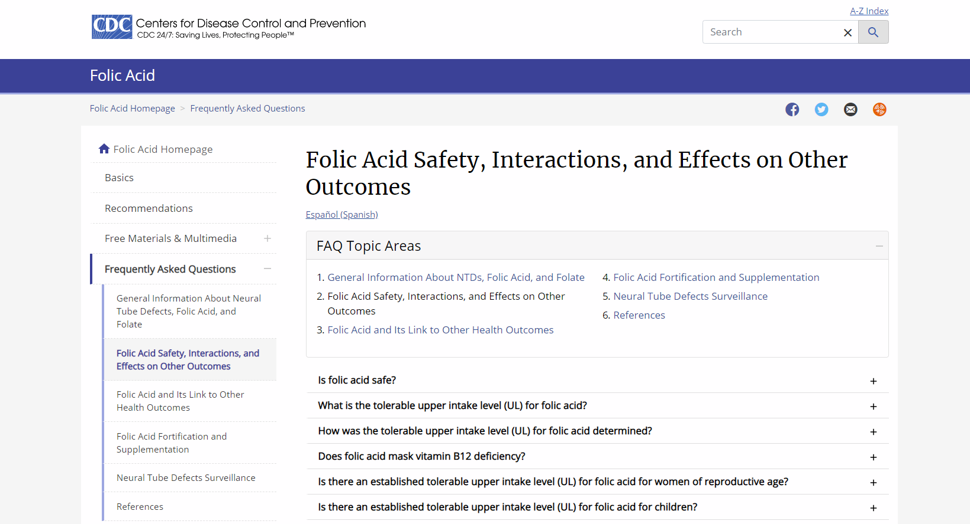
More information on the safety of folic acid
https://www.cdc.gov/ncbddd/folicacid/faqs/faqs-safety.html
Notes:
For more information on the safety of folic acid, please visit this website from the US Centers for Disease Control and Prevention: https://www.cdc.gov/ncbddd/folicacid/faqs/faqs-safety.html
There are also additional resources in the USB thumb drive that you will receive at the end of the meeting.

Slide 28


For more information:
www.FFInetwork.org
www.Facebook.com/FFInetwork
https://twitter.com/FFInetwork
https://www.linkedin.com/company/food-fortification-initiative/ How to cite this document: Food Fortification Initiative (FFI), Organization Title (if applicable). Title of Document. Atlanta, USA: FFI, Year. Available from www.FFInetwork.org. Accessed on [date].
Contact:
Helena.Pachon@emory.edu
SMARTER
STRONGER
HEALTHIER
Notes:
Also, you can contact the Food Fortification Initiative through these links. And, you can reach me via email.
Thank you.

