Slide 1
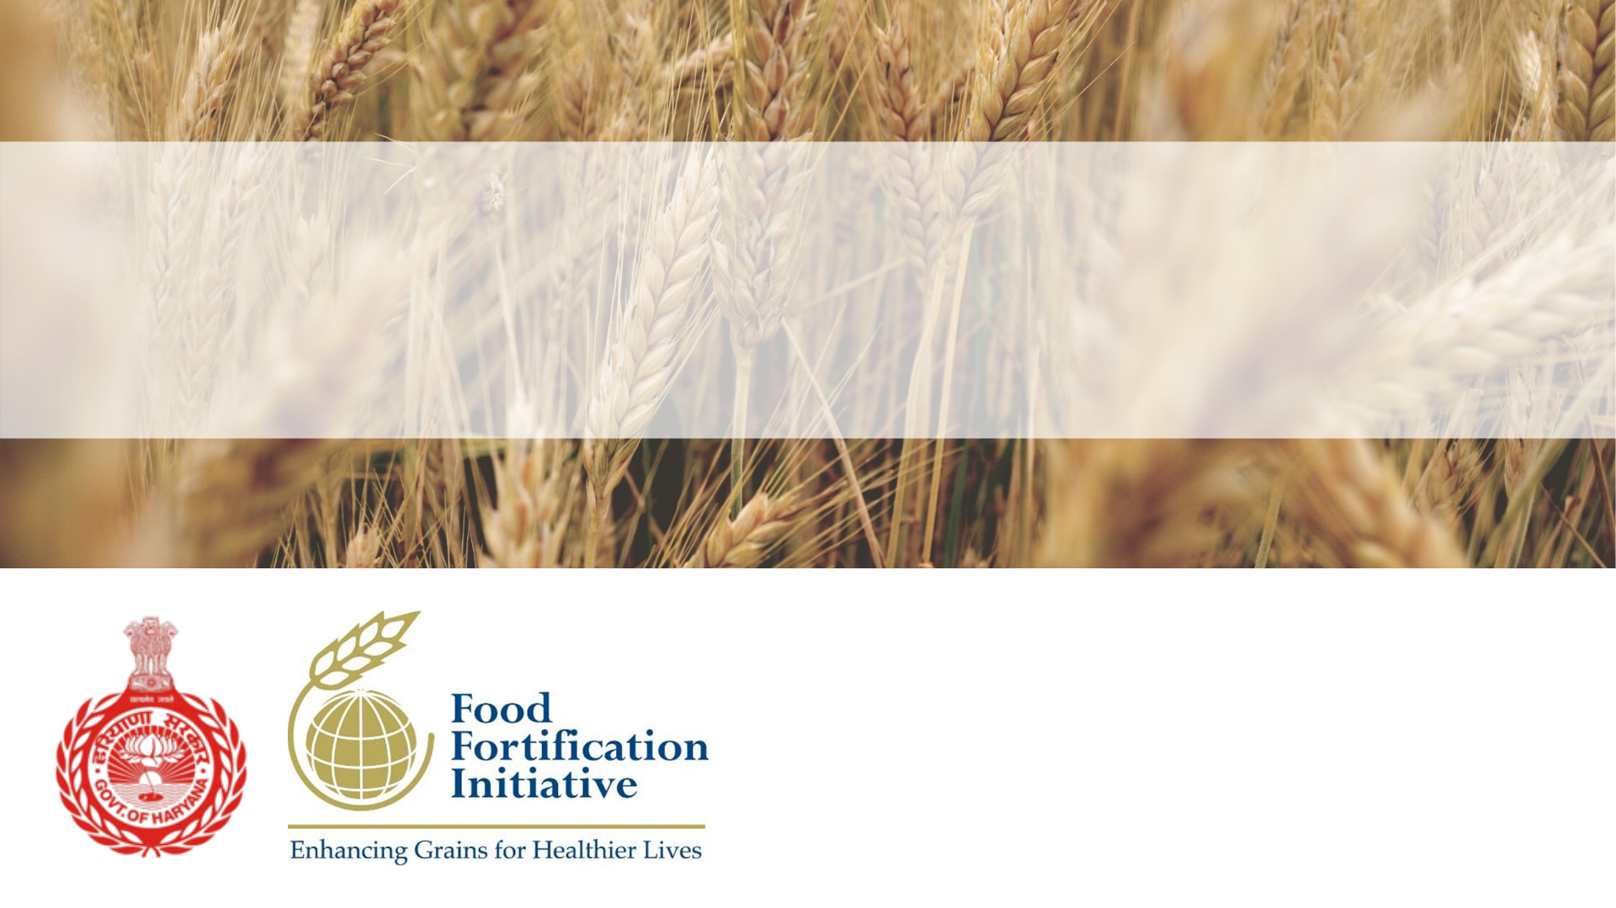
Preventing neural tube defects in Haryana, India: A project to implement wheat flour fortification in the Public Distribution System and safety net programs
Dr. Sonia Trikha
Director Health Services
Executive Director HSHRC
Haryana, India

Slide 2
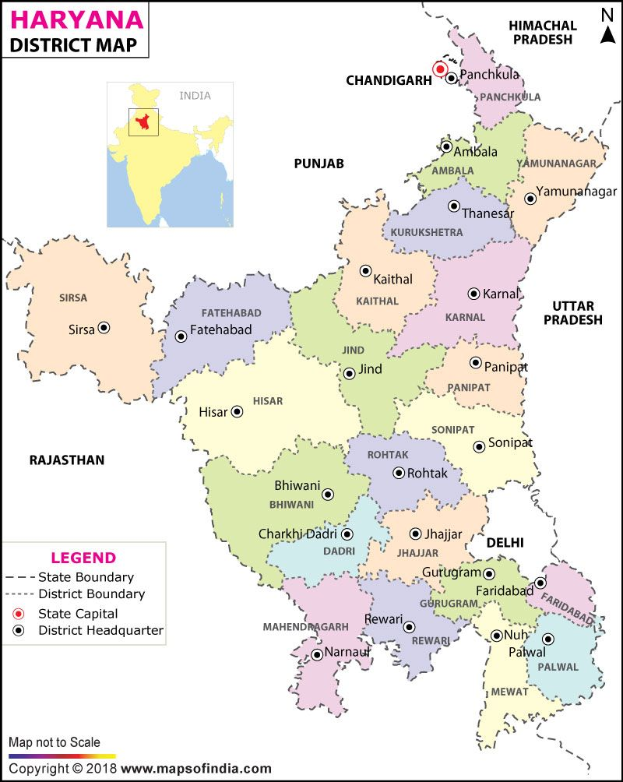
About Haryana
State with the highest per capita income in India
Source: Central Statistical Organisation,Govt. of India
One of the major contributors to the national food basket
Source: Economic survey of Haryana (2017-18)
Notes:
Haryana is one of the north Indian states. Has the highest per capita income among the larger states.
One of the major contributors to national food basket (Cereals and pulses)
All villages electrified way back in 1970s. One of the most progressive states of India.

Slide 3
High prevalence of anaemia and NTDs
Highest percentage of anaemic
children in India
Source: National Family Health Survey-4
3rd highest percentage of anaemic women and pregnant women in India
Source: National Family Health Survey-4
Amongst states with high prevalence of NTDs in India (>4 per 1000 births)
Source: Community Genet 2002;5:192–196
Notes:
Highest percentage of anemic children among larger states in India
Nothing much has improved between over a decade. Between NFHS 3 (2005-06) and NFHS 4 (2015-16)

Slide 4
Why focus on anaemia?
Affects all age-groups, economic strata and gender
Compromises maternal & child health
Impairs cognitive development
3
2
4
Impairs physical work capacity
ANAEMIA
Hurts economic development
1
5

Slide 5
Why focus on NTDs?
High prevalence (4.1/1000 births)
Disability and death
2
High direct and indirect costs
Neural tube defects
1
3

Slide 6
Some other worrying indicators
State has the lowest consumption of iron-rich foods among children (1%)*
Studies have shown high prevalence of vitamin B12 deficiency among women and children in Haryana**
Every 3rd child is stunted
Every 5th child is wasted
*Comprehensive Nutrition Survey 2018. Food Nutr Bull. 2007 Dec;28(4):435-8. DOI: 10.7860/NJLM/2018/36190:2315.
**Current Developments in Nutrition, Volume 3, Issue Supplement_1, June 2019, nzz034.P10-117-19, https://doi.org/10.1093/cdn/nzz034.P10-117-19
Notes:
Apart from the high burden of anemia and NTDs, other nutritional indicators are quite worrying. Every 3rd child is stunted and every 5th child is wasted.

Slide 7
National Nutrition Strategy and Poshan Abhiyaan
The National Nutrition strategy based on a life cycle approach was released in 2017 enlisting various nutrition interventions to address the issue of malnutrition.
Nutrition Interventions
Infant and Young Child Care and Nutrition
Infant and Young Child Health
Maternal Care, Nutrition and Health
Adolescent Care, Nutrition and Health
Addressing Micro-nutrient deficiencies
Community Nutrition
In 2018, Poshan Abhiyaan was launched with a aim to build a people’s movement around malnutrition and intends to significantly reduce malnutrition in the next 3 years i.e 2022. Food Fortification is one of the broader themes under Poshan Abhiyaan

Slide 8
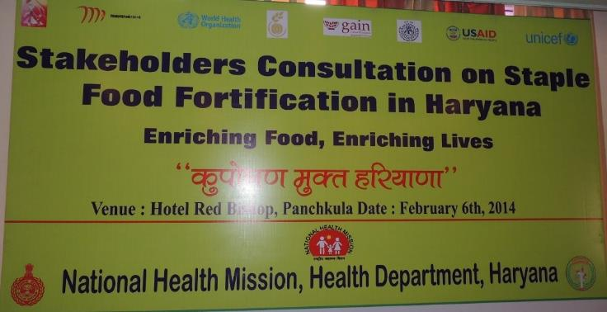
Haryana’s proactive approach to address micronutrient deficiencies
Conducted a workshop in 2014 with various stakeholders to discuss on strategies to initiate food fortification in Haryana
Haryana decided to address the issue of micronutrient deficiencies at the Global Summit on Food Fortification, Arusha 2015
Notes:
Haryana realized the importance of addressing the micronutrient deficiencies and took a proactive approach in 2014 and conducted a multi-stakeholder workshop on staple food fortification.

Slide 9
Govt. of Haryana collaborated with various partners to launch Haryana demonstration pilot project for wheat flour fortification
Funding for baseline survey with biomarker analysis and technical support
Technical support in development of project proposal
Wheat flour supply chain, milling industry assessment and cost projections
Household and biomarker survey in two blocks of Ambala
Birth defects surveillance and community needs assessment
Notes:
In line with the vision to address the micronutrient deficiencies in Haryana, the state collaborated with various development partners to launch the Haryana Demonstration Project on Wheat Flour Fortification in two blocks of Ambala district.

Slide 10
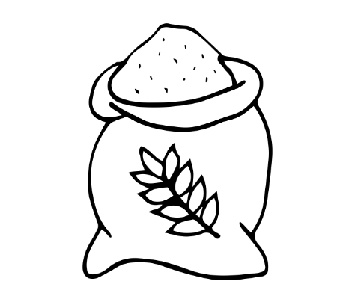
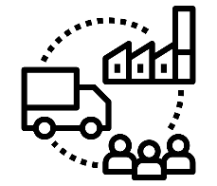
Three phases over five years (2016-2020)
The pilot aims to assess the feasibility, sustainability and health impact of fortifying wheat flour using existing open market and government systems (PDS, MDM and ICDS)
Phase-1
Phase-2
Phase-3
Completed in Nov. 2017
Started in Mar. 2018
Planned for end of 2020
Notes:
Public Distribution System (PDS)
Mid-Day Meals (MDM)
Integrated Child Development Services (ICDS)
Phase-1 comprised of household bio-marker survey (hemoglobin, ferritin, red blood cell folate and
serum folate and vitamin B12), Community needs assessment (for acceptability of fortified wheat flour), Supply chain analysis (to assess the capacity of flour mills along with distribution channels) and Birth defects surveillance (to assess the burden of birth defects)
Phase-2 i.e distribution of fortified atta started in March 2018 in the two blocks of Naraingarh and Barara. Apart from this regular assessment of usage, acceptance and quality will be done.
Phase 3 i.e endline survey with bio-markers will be conducted by the end of 2020.

Slide 11
Baseline survey shows moderate to severe deficiency in hemoglobin, serum folate and vitamin B12
Test parameters | Deficient or insufficient (%) | Normal (%)
Hemoglobin levels < 11g/dL | 53.3 | 46.7
Iron stores < 15 ng/mL | 71.7 (74.94%) | 28.3
Serum folate <7 nmol/L | 11.0 deficient | 89.0
RBC folate <305 nmol/L RBC folate <748 nmol/L | 10.2 deficient 79.8 insufficient | 89.8 20.2
Vitamin B12 <201 pg/mL Vitamin B12 <301 pg/mL | 60.4 (severe and moderate deficiency) 82.2 (severe, moderate and marginal deficiency) | 39.6 17.8
Notes:
2 out of 3 women are deficient in iron stores
Almost 80% of women have folate insufficiency which is one of the risk factors for NTDs
82% of women are Vit. B12 deficient (ranging from mild to severe)

Slide 12
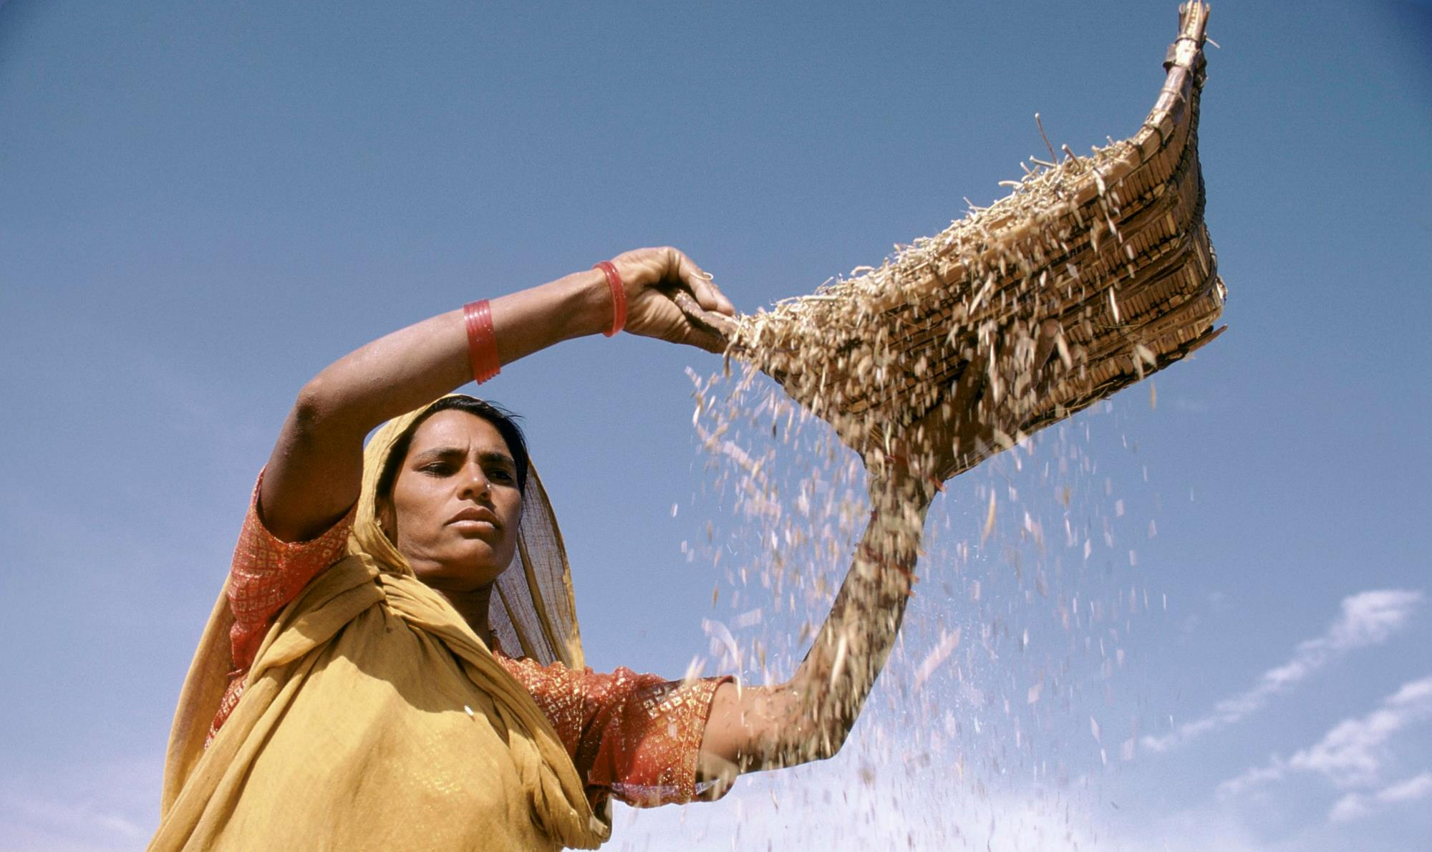
Advocacy and political will
Series of advocacy meetings and discussions with concerned departments
Cost to the beneficiary was one of the major challenges to launch this project
Hon’ble Chief Minister made an announcement that the beneficiary will be charged only Rs. 5 per Kg and any cost over and above that will be borne by the state
HAFED was chosen as the nodal agency to get the wheat processed
FFI provided technical support in supply chain assessment and developing tender document
HAFED: Haryana State Co-operative Marketing and Supply Federation
Photo: Ray Witlin
Notes:
A lot of apprehensions from Food and supplies department as wheat flour distribution under Public Distribution System (PDS) was discontinued twice after few years of implementation.
There was lot of deliberation on the final cost to be charged from the beneficiary.

Slide 13
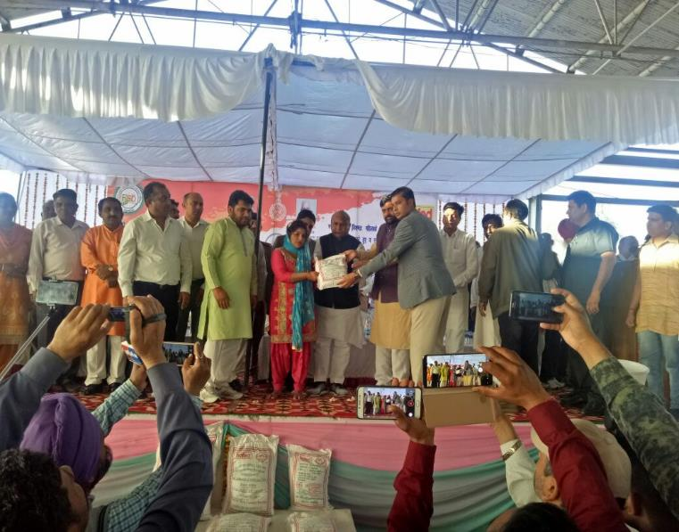
The beginning
March 2018: Distribution of fortified wheat flour (iron, vitamin B12 and folic acid) as per FSSAI’S 2016 standards under PDS in 2 blocks of Ambala
1000 MT reaching 177,000 beneficiaries per month
June 2018: Use of fortified wheat flour in ICDS started in 2 blocks of Ambala
June 2018: HAFED started supply of fortified wheat flour in open market
FSSAI: Food Safety and Standards Authority of India
Notes:
Phase of the pilot i.e distribution of fortified atta under PDS started in March 2018. The atta was fortified using FSSAI’s 2016 standards that were in line with the WHO’s recommendations on wheat flour fortification.

Slide 14
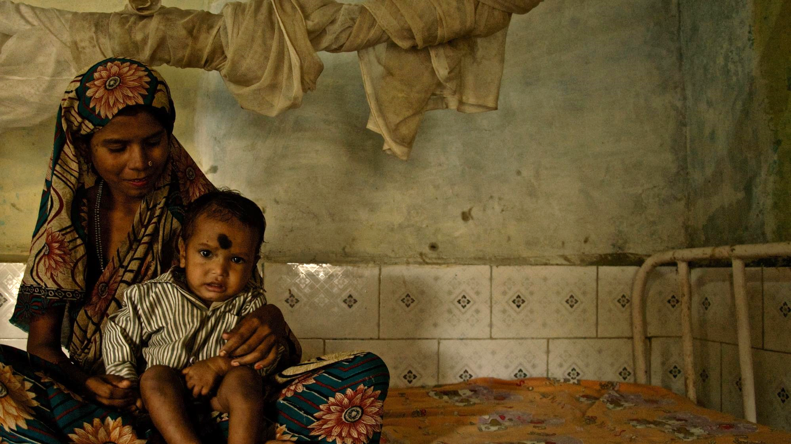
Initial learnings
Initial resistance from some pockets in two blocks of Ambala due to vested interests
Continuous engagement with beneficiaries and sustained efforts to address their concerns
Feedback from beneficiaries and field observation led to shift from roller mill atta to chakki (stone ground) atta
Photo: Arjun Claire

Slide 15
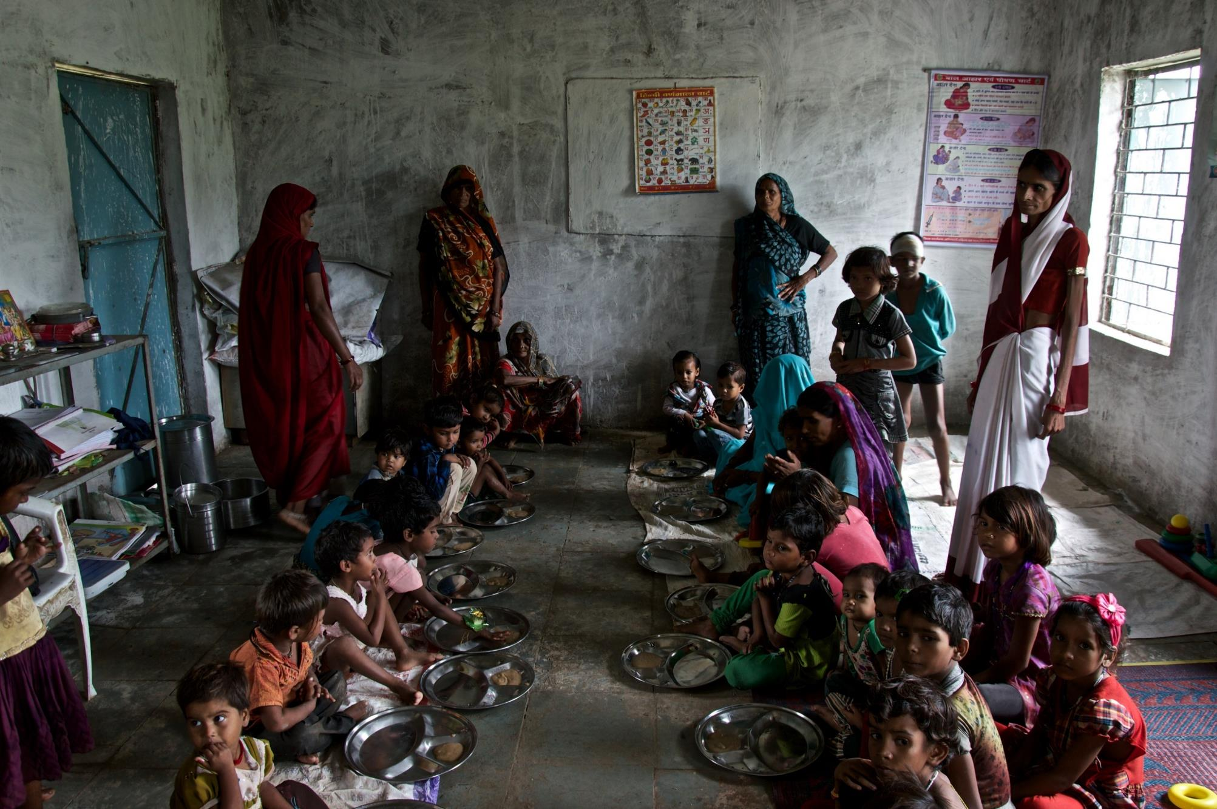
Positive outcomes
The offtake of fortified atta increased to 96% compared to 80% for wheat grains
Many millers installed additional chakki lines and the total production capacity in Haryana has increased by 30-35%
More millers have shown interest to get empaneled and work for the state
Photo: Arjun Claire
Notes:
Under PDS, the offtake of fortified atta increased to 96% compared to 86% wheat grains. This showed more acceptability for the fortified atta.
Millers were motivated with the success of this program and installed more chakki lines to increase their production capacity in case of scale-up. The production capacity for the entire state increased by 30-35%.
More millers approached state to get empanelled I case the project is expanded to other districts of Haryana.

Slide 16
Scale-up of fortification
112 Millers empanelled for scale-up
2 districts added under PDS
6 Districts added under ICDS and MDM
5 more districts roll out Wheat flour fortification for PDS
Jan 2019
Feb 2019
July 2019
Oct. 2019
Notes:
With the successful implementation of phase-2 of the wheat flour fortification pilot and high acceptance for the fortified atta, the government planned to scale up the project in a phase wise manner across all safety net programs. FFI provided technical support in refining tender documents, planning and scaleup.
In Jan 2019, a new tender was floated and 12 millers were empanelled to scale up the project in 2 entire districts under PDS from Feb. 2019. Later on in July 2019, wheat flour fortification was introduced under ICDS and MDM in 6 districts of Haryana.
By Oct. 2019, 3 more districts were added under PDS and the almost 1/4th of Haryana was covered under PDS.
FSSAI came up with new fortification standards in Oct. 2018 and the levels of micronutrients for wheat flour fortification especially folic acid and Vit. B12 that were significantly lower than 2016 standards. From July 2019 these standards are being followed in Haryana.

Slide 17
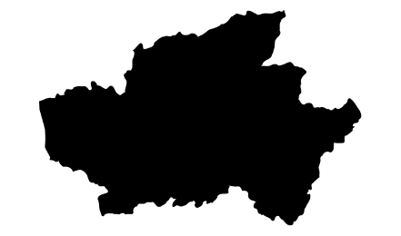
Fortified Atta under PDS in Haryana
1,027
2
7,600 MT
1.4 m
5
17,500 MT
2,599
3.3 m
PDS: Public Distribution System
Notes:
A journey that started from only two blocks of Ambala District in March 2018 distributing 1000 MT of fortified atta per month and reaching 175,000 PDS beneficiaries was expanded to two entire districts in Feb 2019 distributing 7600 MT of fortified atta reaching 1.4 million beneficiaries and currently we are covering 5 districts and distributing around 17500 MT of fortified atta per month to 3.3 million beneficiaries.

Slide 18
Fortified Atta under MDM and ICDS in Haryana
6
975 MT
382,037
450 MT
290,000
MDM: Mid-day Meal
ICDS: Integrated Child Development Scheme

Slide 19
Way forward
Scale up wheat flour fortification in entire state in phase wise manner under all safety net programs (PDS, ICDS and MDM)
Revert to FSSAI’s 2016 wheat flour fortification standards (in line with WHO recommendations)
Increase awareness among masses for demand generation for fortified food products
Augmentation of state food labs and institutionalize quality assurance mechanism
Constitute a monitoring mechanism for review of programme activities
Explore the possibility of mandatory wheat flour fortification in Haryana
Photo: Arjun Claire
Notes:
Wheat flour fortification will be expanded to cover half of the state before March 2020 and to entire state by end of 2020.
To reduce the NTDs, state will adopt the FSSAI’s 2016 wheat fortification standards that are in line with WHO’s 2009 recommendations.

Slide 20
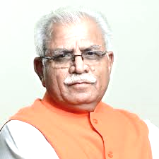
Government of Haryana is committed to address micronutrient deficiencies in the state

